Slide 1
ReactJS + Django How to Reactify Your App
Alli DiNapoli
Notes:
I can’t wait to hear your…. REACTIONS after this talk (probably don’t actually say that) (or maybe do)

Slide 2
Why React?
In my humble opinion, it’s a lot easier to learn than vanilla javascript, and it’s definitely a lot easier to read
React is incredibly efficient
It uses a Virtual DOM stored in memory. It compares the updated Virtual DOM with the previous version, and calculates the minimum number of updates necessary to update the DOM.
It’s great for SEO
Great Developer tools
It’s responsive
I could honestly continue for ages here
Notes:
Talk about looking at someone else’s messy javascript jquery code and literally wanting to die (don’t actually say that) trying to understand it. Talk about how much easier it is to read and parse react code. v nice to read
Search engines often have a hard time reading javascript-heavy applications, but not with react!

Slide 3
But I already have Django templates!
Components are more decoupled, isolated, and testable than templates
Django templates tend to fall short when trying to manage complex state in the browser
jQuery used to be the standard tool to use with Django to add interactivity, but as single page web apps become standard, maintaining intricate jQuery logic isn’t the best practice anymore

Slide 4
Basic React Vocabulary
Components
Components let you split the UI into independent, reusable pieces, and think about each piece in isolation (source)
They are displayed like html elements <Example />
Properties
Properties are inputs and should remain constant
<Example property1={value} />
States
States are initialized in the constructor and are meant to change over time
They determine how the component renders and behaves
The state is updated by calling this.setState({name:value})

Slide 5


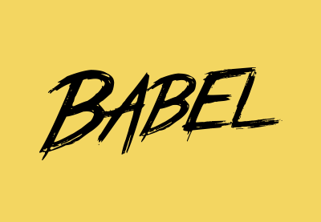




Tools
z
z
These are going to be our main players while adding React into our Django application.
Notes:
These are the tools we will use!!! :D

Slide 6
What about existing jQuery?
Adding another library (ie, jQuery) adds a significant amount of overhead to the application, impacting the load for users
Everything that can be accomplished with jQuery can be done easily with react, or just plain Javascript
React is unaware of the changes made to the DOM outside of React
If you really need it, there are lightweight alternatives such as minifield.js and Zepto.js that use a similar syntax
Conclusion:

Slide 7

Burn it. Burn it with fire.
Notes:
Maybe make a funny comment about just wanting to include this gif?
While it is possible to integrate react with existing jQuery, my recommendation would be to not. Just give it up. All hope is lost. jk But for real, it’s a lot of overhead to try and integrate it, and can get unnecessarily complex. It’s much easier to replace it with react than it is to try and slowly integrate it.
I’ve heard of people converting all jQuery to vanilla javascript and then adding in react… you can do this if you don’t have a huge amount of jQuery, or you can try and slowly add it piece by piece while removing jQuery as you go… but that can get difficult as well if you have a lot of jQuery.
It’s not going to be fun, but it is going to be worth it.

Slide 8
So let’s get started with React!

Slide 9
First things first, install NodeJS and npm
curl -sL https://deb.nodesource.com/setup_6.x | sudo -E bash
sudo apt-get install -y nodejs
NodeJS is a javascript library, and npm is the package manager for NodeJS.
npm will be used to pull various libraries (such as react) and to help build our javascript files from the React jsx syntax

Slide 10
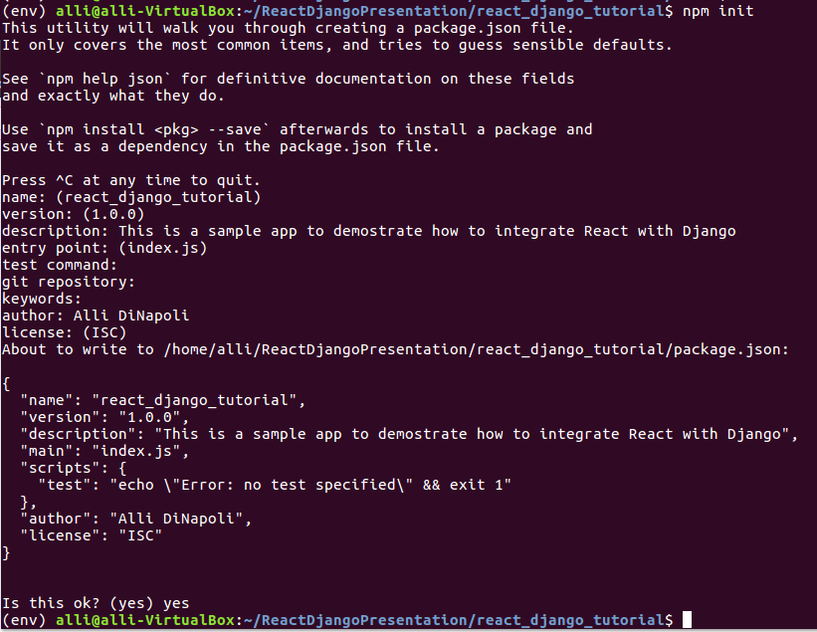
npm init
Creates package.json
You can enter in the default values for all of these.
Notes:
run npm init in the same directory that contains your manage.py
or don’t, but I find it easier to run everything from one directory instead of jumping around. also all javascript and react should be in sub directories from this

Slide 11
Install Webpack with npm
npm install webpack webpack-bundle-tracker --save-dev
This is the basic syntax for installing a package from npm
--save-dev and --save place the file in package.json
This is incredibly important to use, because it keeps track of your dependencies.
When pulling code from git, you can run npm install and it will automatically install all packages in package.json
We’ll look at the structure of package.json in a little bit

Slide 12
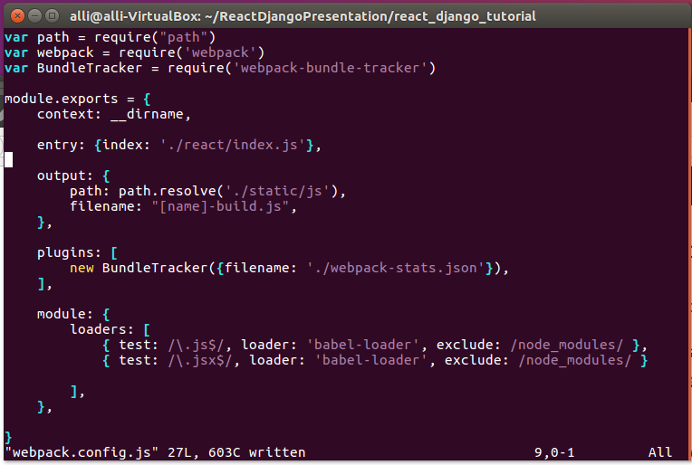
Create webpack.config.js
Take note of entry and output
You can have multiple entries
Notes:
Your entry is going to be the react file or files that will be compiled into javascript using webpack and babel
Your output is going to be the static javascript files that are created from it, you should place these in your static directory
Note that this should be in the same directory as your package.json

Slide 13
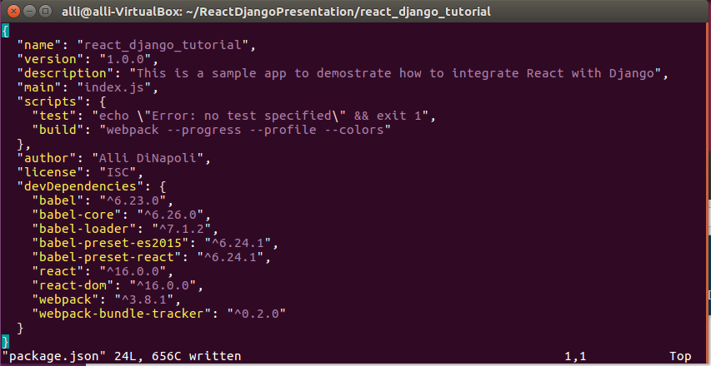
package.json
This is all automatically generated from the npm init except for the build value in scripts
Add this to compile your react on the command
npm run build
SPOILER ALERT!
There are packages here that haven’t been installed yet

Slide 14
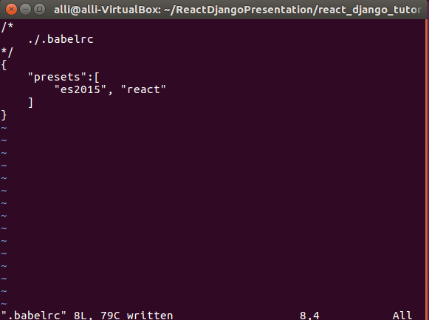
Install Babel and create a .babelrc file
npm install babel-loader babel-core babel-preset-es2015 babel-preset-react --save-dev
/*
./.babelrc
*/
{
“presets”:[
“es2015”, “react”
]
}
Notes:
babel is a javascript compiler. this enables babel to compile to ES6 and React

Slide 15
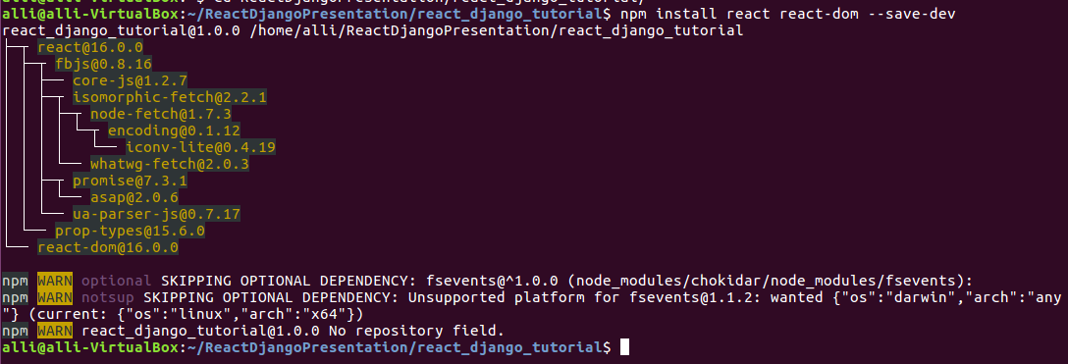
Now let’s finally install react
npm install react react-dom --save-dev

Slide 16
Where to put react code?
My personal recommendation is to have a separate folder for your react code but you can organize it however you wish
I would not recommend placing it in your static folder, but it’s not compiled and ready for the browser yet

Slide 17
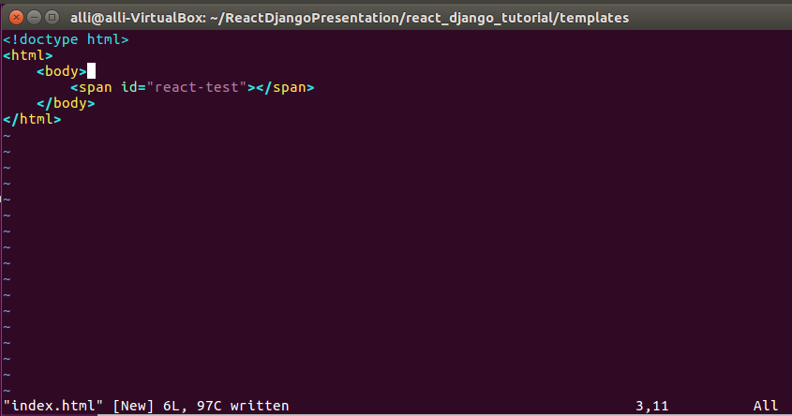
Django Template
This is an incredibly basic template just as an example
We add a span (or div) with a unique label wherever we want our react components to go

Slide 18
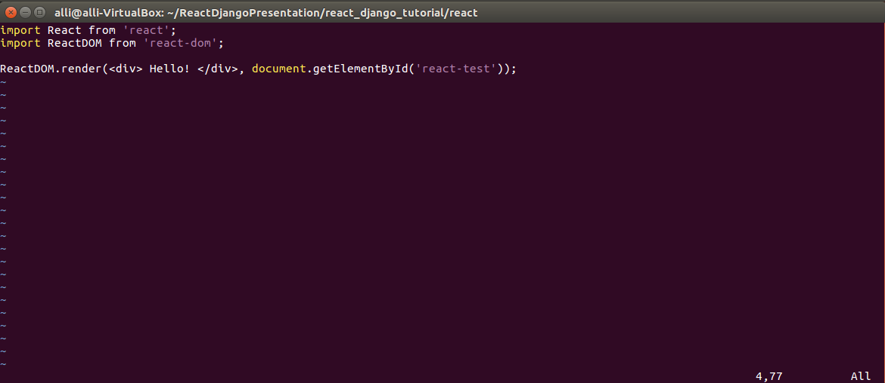
index.js - React
This file will be where we place our components on the page
I’m just using a div as an example to test – we’ll get to react components in a second

Slide 19
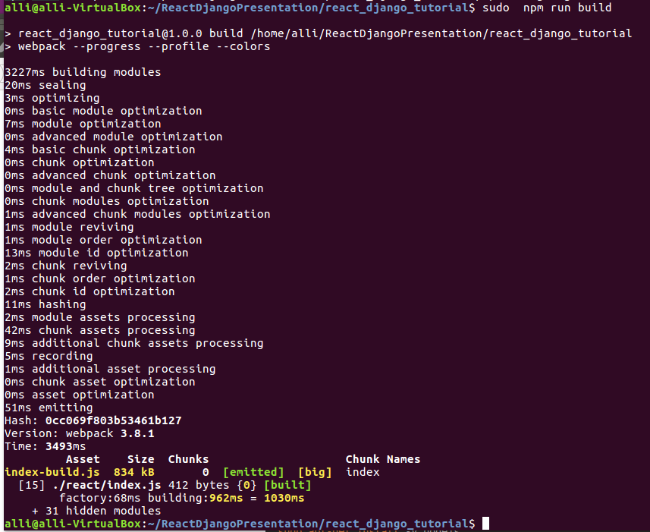
npm run build
Remember adding the build script to package.json? This is where that comes into use.
It uses webpack to compile with babel and places the compiled javascript into the static folder as specified in the webpack config

Slide 20
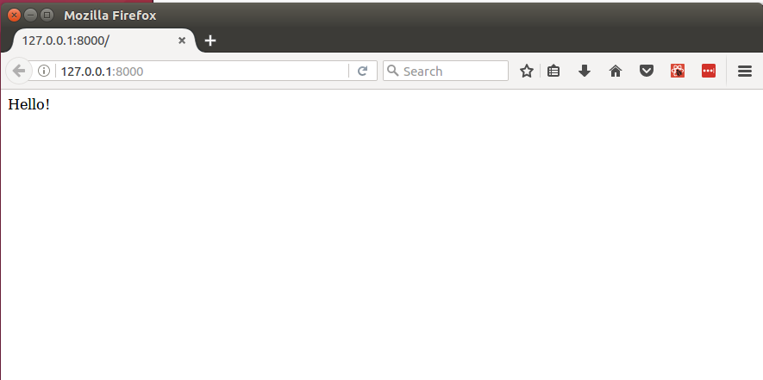
It works! So responsive! Viewable on any browser!

Slide 21
Adding React Components
Within the react directory, we’ll create a new directory called components.
In this directory we can create different components that can be easily placed into our webapp from the index.js file

Slide 22
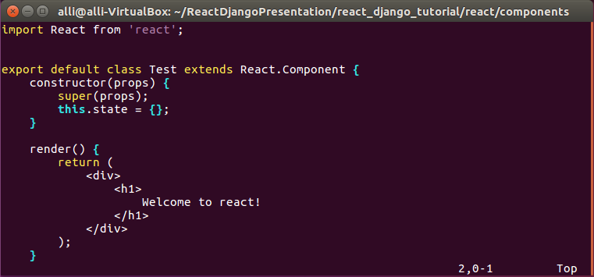
Adding React Components
This is the syntax for a very basic react component
States, props (properties), and plain javascript functions can be added as needed

Slide 23
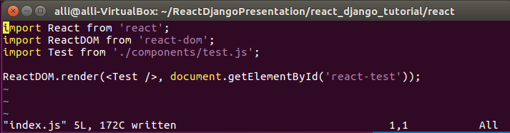
Our new index.js
Notes:
don’t forget to npm run build

Slide 24
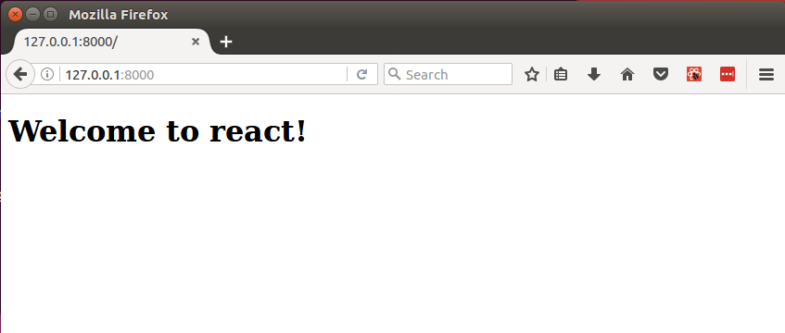
Wow. So breathtaking. Very beautiful

Slide 25
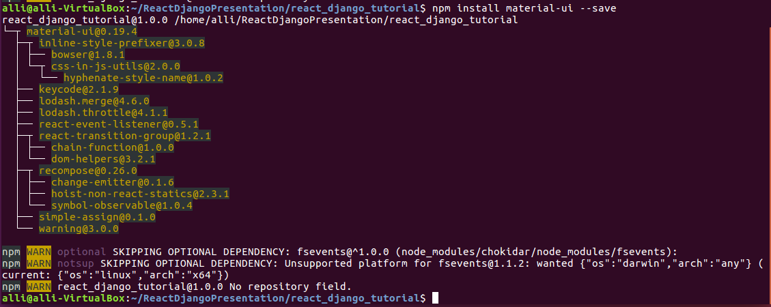
Leveling up our react components
There are a TON of open-source libraries to help with creating attractive components, or you can create your own!
I’ll give a quick example using material-ui, Goggle’s material design
npm install material-ui --save

Slide 26
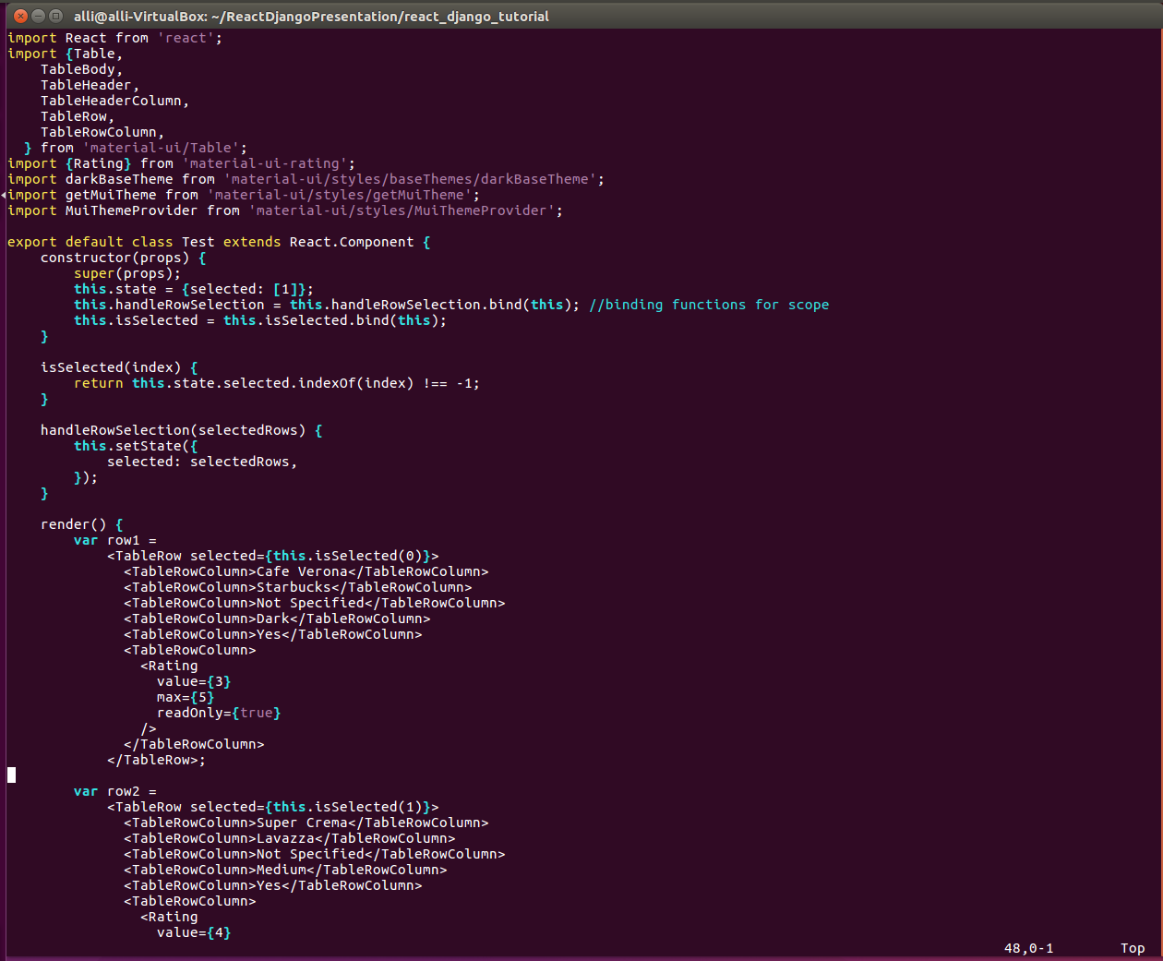
Material UI part 1
Notes:
Hard-coding is my passion
jk
this is just for the tutorial
realistically you would have a database with this info but #rip
Look at all this code! Point out how we’re setting variables in the render function that’s cool! gloss over states

Slide 27
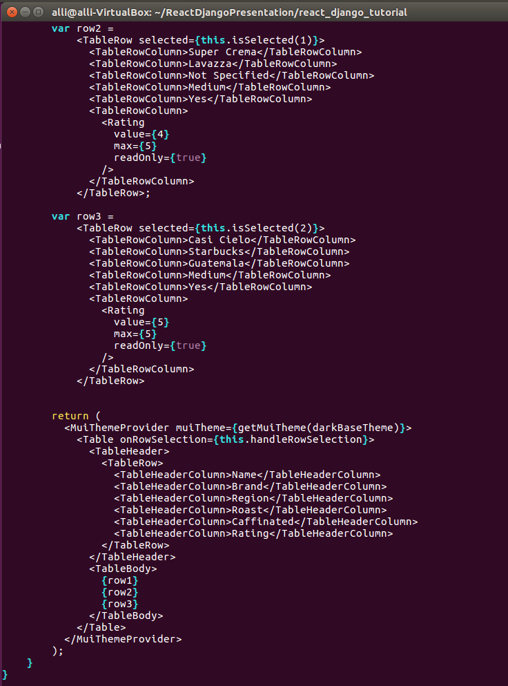
Material UI part2

Slide 28
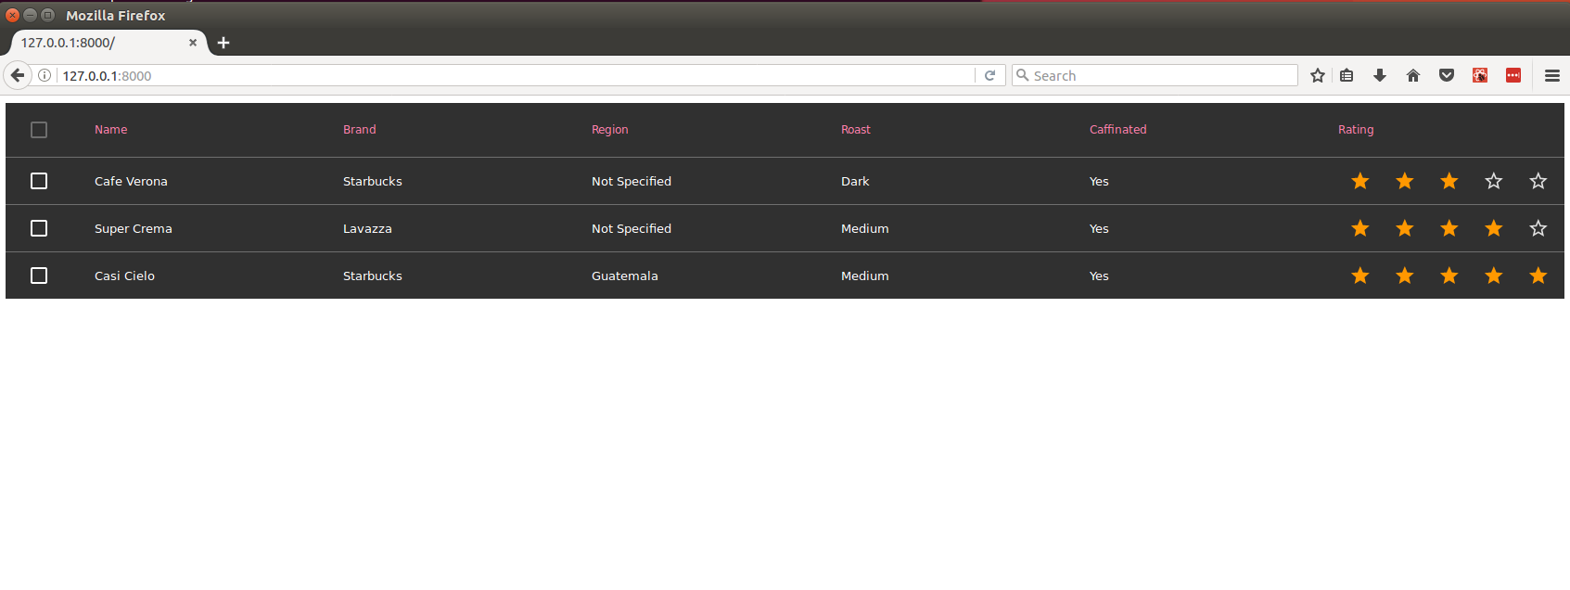
Consider this app… reactified

Slide 29
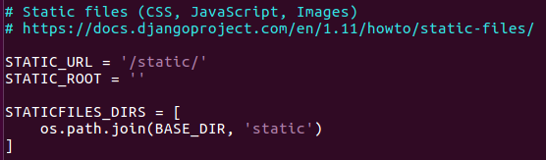
Additional Notes
Make sure your static files are set up properly in settings.py (here’s what mine look like)
There is a really nice browser extension in Chrome and Firefox that allows you to debug react with developer tools
Passing data from Django to React can be done either with an API or with global js variables set inside a <script> element in the template where the react component is placed.
https://github.com/allison-dinapoli/react-django-tutorial

Slide 30
Conclusions!
React and Django are the perfect combination!
Integrating React into Django requires a few tools, but once set up it is very easy to maintain and build up.
Using React with Django adds a whole new library of open source code to help you build your app (ie material-ui)
Notes:
Django lets us have a very intricate backend while maintaining the best possible front end. It’s interactive and amaze

Slide 31

Fin.
Questions? Comments? REACTions?

